Slide 1

BANK STRUCTURE
Prepared By
Aayushya Aggarwal
Divya Kansal
Karan Khanna
Mukul Nagpaul
Rishabh Bajpai
Swapnil Aggarwal

Slide 2
INTRODUCTION
BANK STRUCTURE
Head Office
Zones
Zone 1
Zone 2
Branches
Branch 1
Branch 2
Central Processing Center

Slide 3
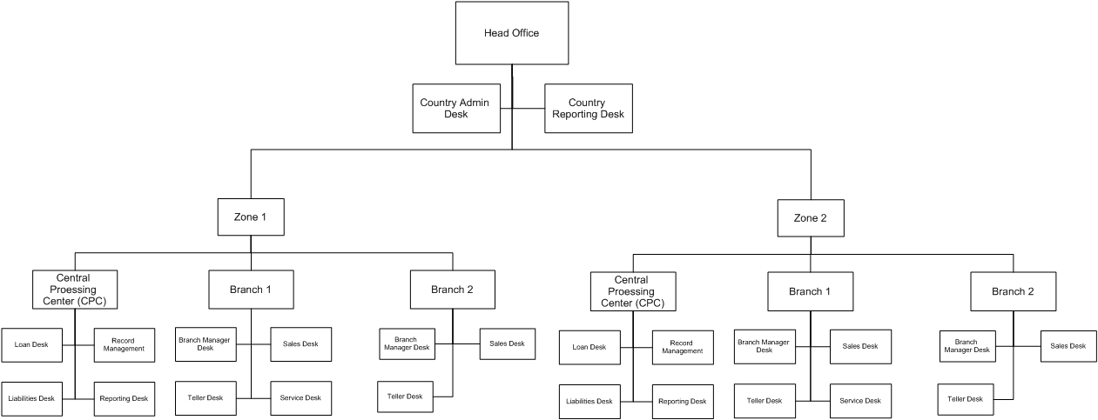
HEIRARCHY

Slide 4
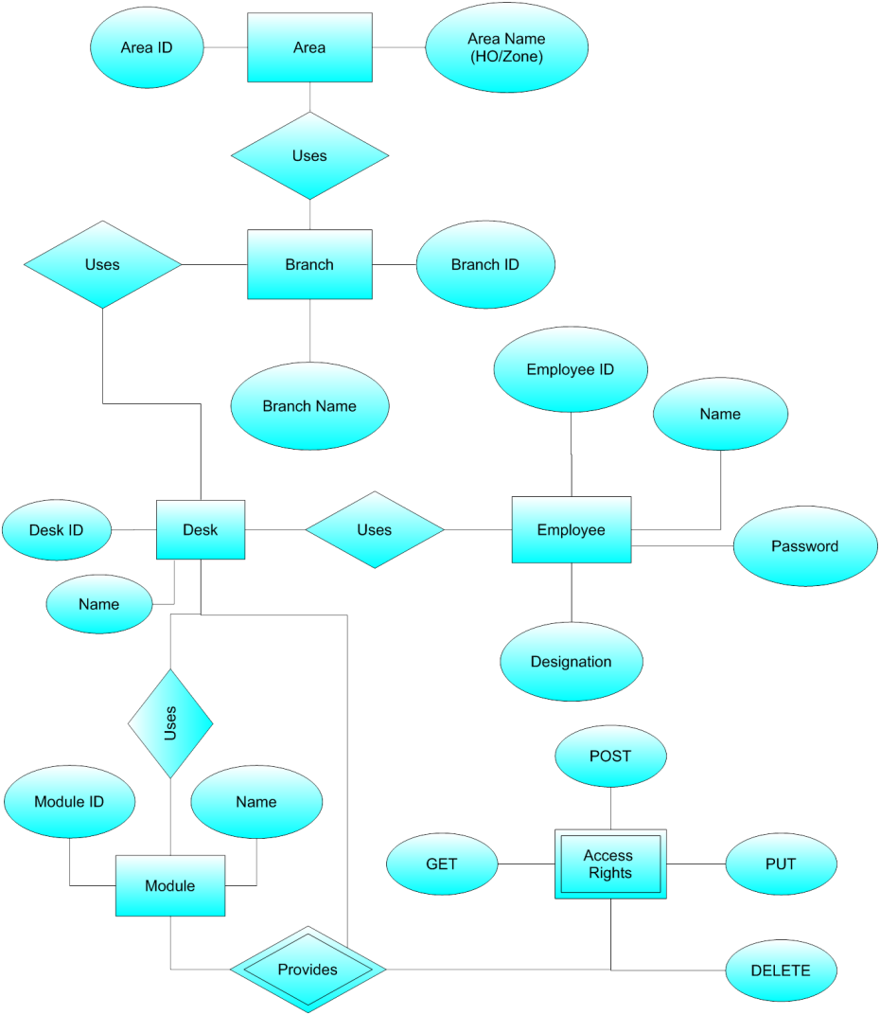
ER DIAGRAM

Slide 5
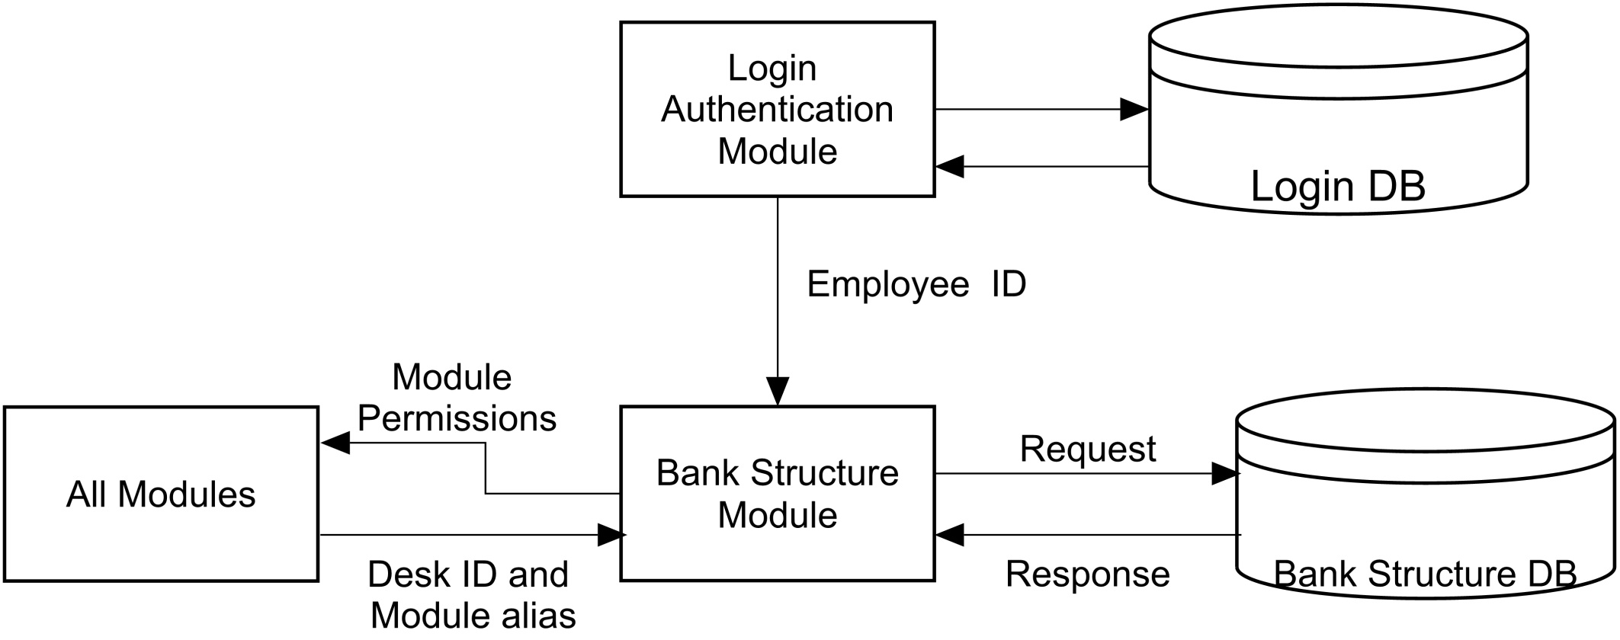
WORKFLOW

Slide 6

FUNCTIONALITY
Get Module Permissions
Get Service Rights Permission
Get Employee Details

Slide 7
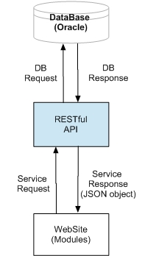
IMPLEMENTATION
RESTful API Architecture
Bean classes
Data Access Layer (Data Access Object)
Service classes

Slide 8
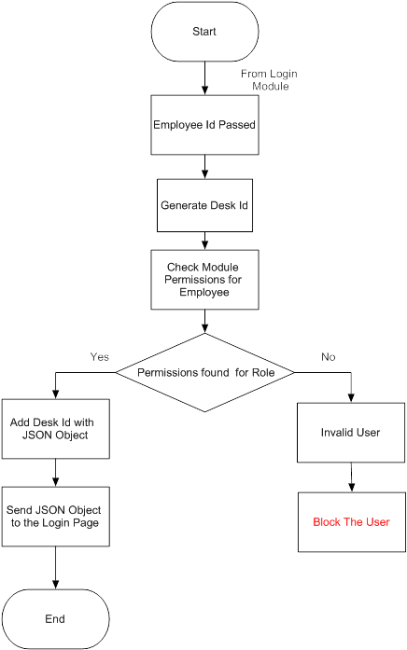
Module Permissions
Input: Employee ID (Provided by Login Authentication (LA) Team)
Output: JSON Object
Desk ID (1-14)
Module Alias (e.g. CM, RD, etc.)
Value (0 or 1).

Slide 9
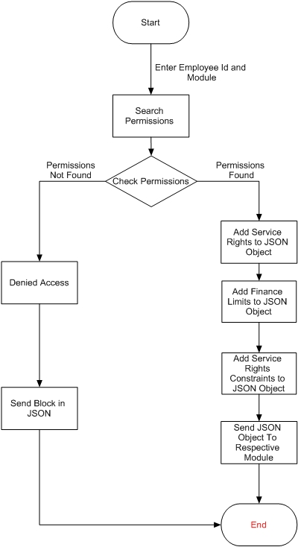
Service Rights Permission
Input: Desk ID and Module Alias
Output: JSON Object
GET, PUT, POST, DELETE permission values (0 or 1)
GET, PUT, POST, DELETE parameter values (strings).

Slide 10
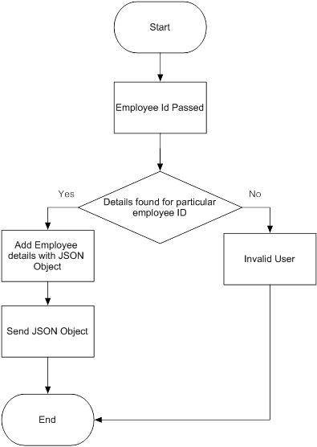
Employee Details
Input: Employee ID
Output: JSON Object- Employee Details:
Area ID and Area Name (HO or Zone ID)
Branch ID and Branch Name (CPC, Branch 1 and Branch 2)
Desk ID and Desk Name

Slide 11
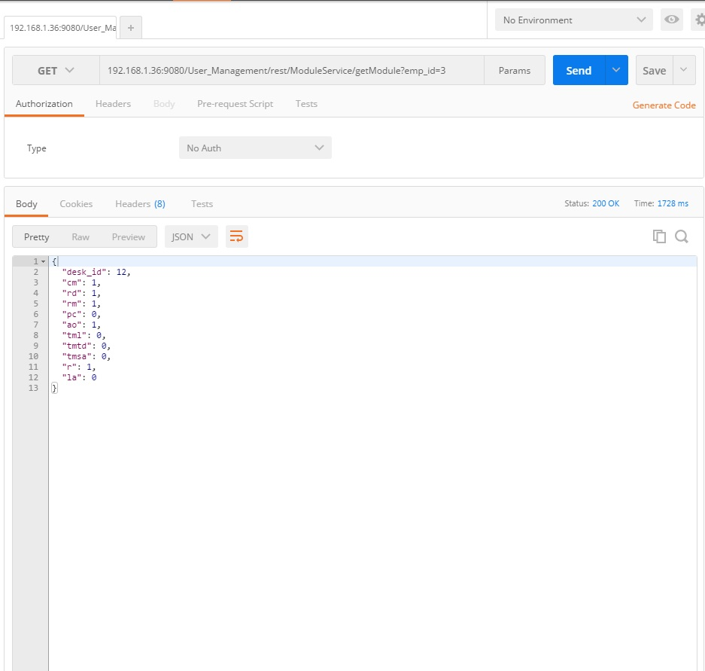
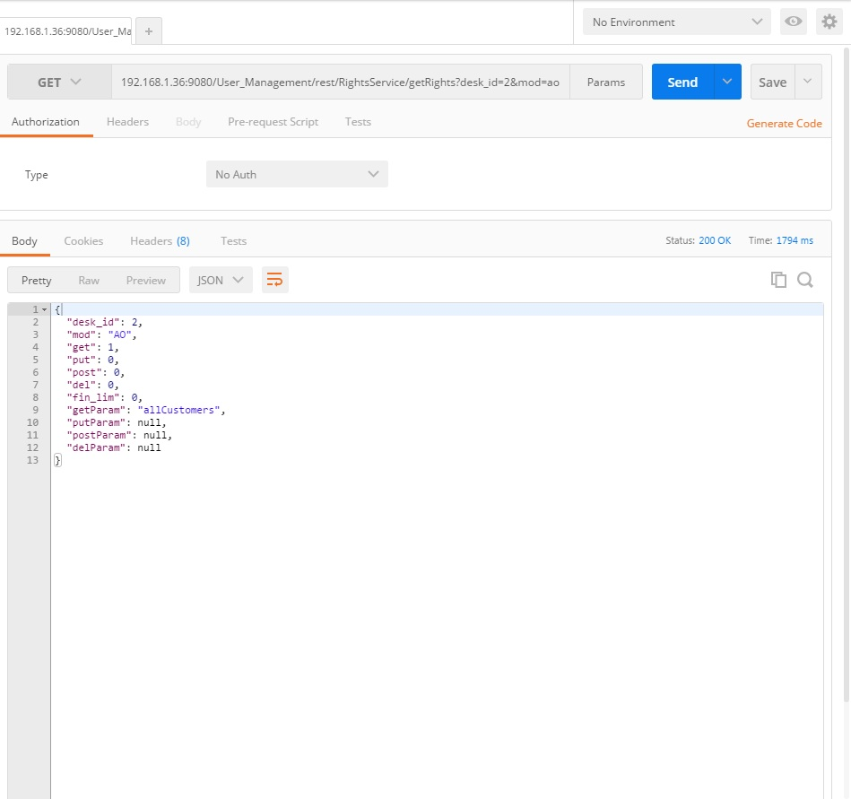
TESTING

Slide 12

LEARNING AND CHALLENGES

Slide 13

THANK YOU!

